Slide 1

BUILDING
Rally Apps
(
)
Extending the Platform
with javascript
Intro & Kickstart

Slide 2
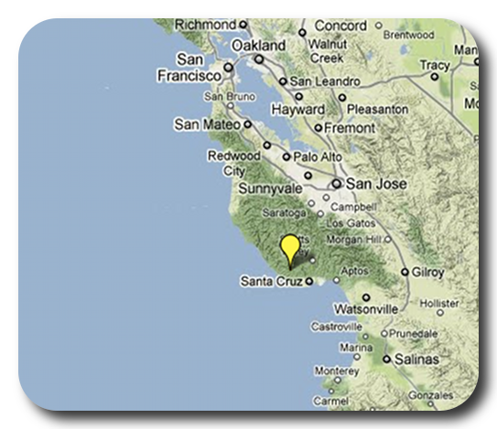

David P Thomas
dthomas@rallydev.com
ME
ABOUT
Notes:
Things that are nice to include in your introduction or things you might think about:
Where are you from?
Where do you work?
A funny Story.
Use some images that show who you are.

Slide 3
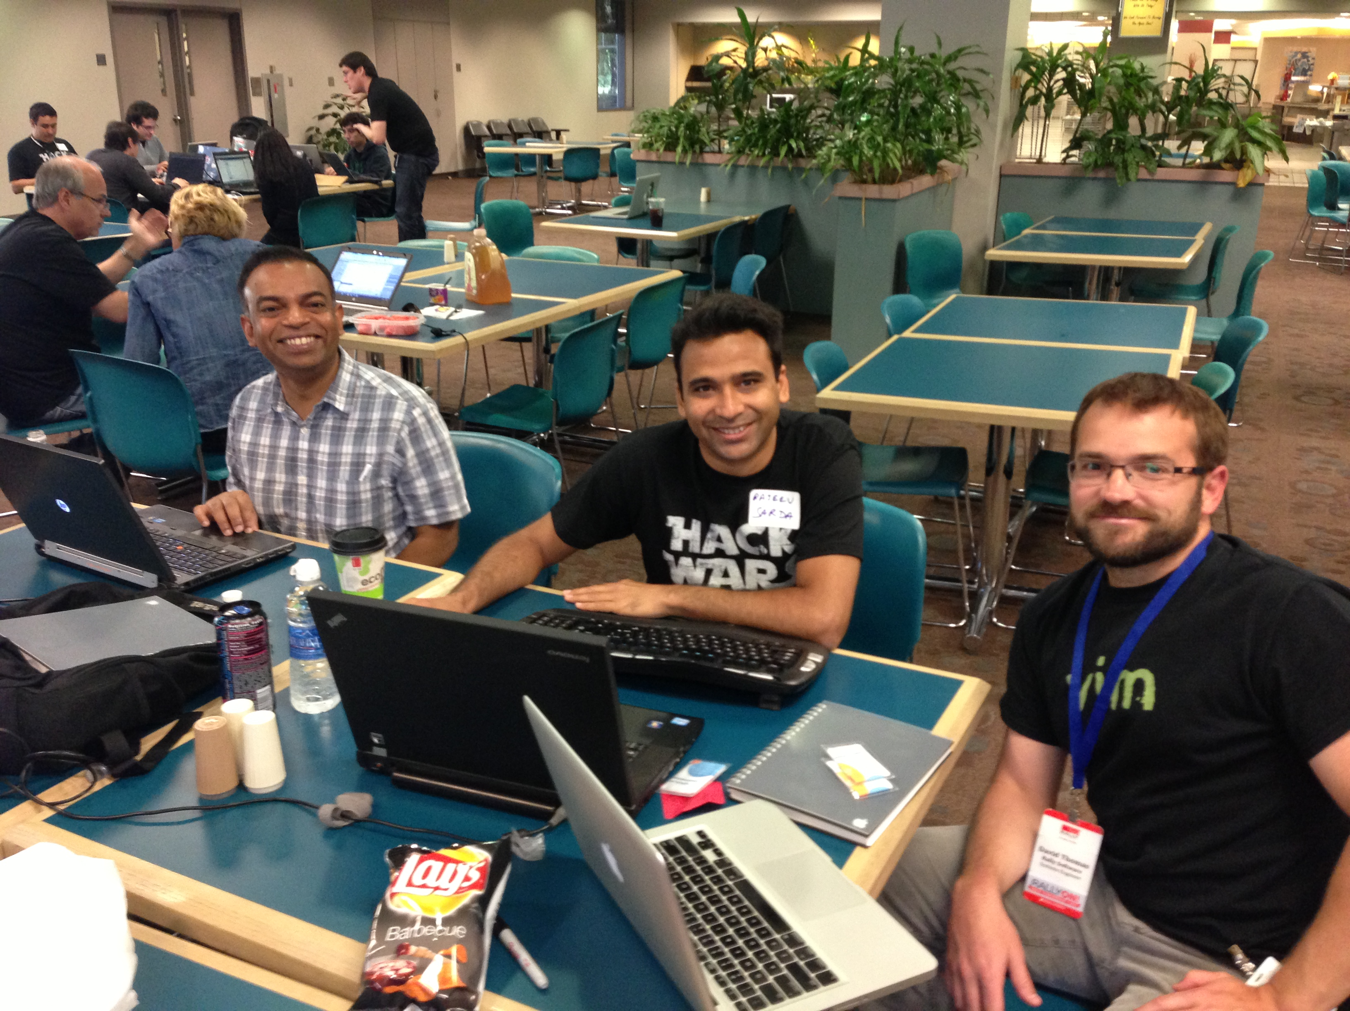
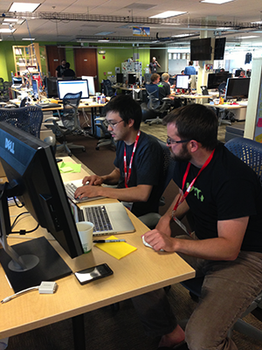

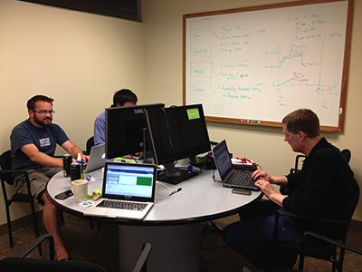

Slide 4
Purpose
As a Rally Customer, I want to be comfortable
extending the Rally platform to provide our
business with unique insights into our own data.
Acceptance Criteria:
Know where to find existing apps
Know where to find help & resources
Start a new app in < 3 minutes
Comfortable trying, failing, debugging, and learning.
Feel overwhelmed with possibilities…
not stress.

Slide 5
Developer Portal
http://developer.rallydev.com

Slide 6
Rally API & SDK
Web Service API (WSAPI) The 2.0 version of the Rally API is REST based and uses the JSON format.
SDK - The App SDK allows you to write apps that extend and customize your Rally subscription. Apps are written in JavaScript and deployed to your Rally subscription within a custom page. The SDK relies on the WSAPI for data exchange.
The App SDK is based on Sencha’s Ext JS and is used by Rally Engineering to build Rally itself.

Slide 7
Disclaimer
I’m not an expert. I learn every day.
I’m just a passionate programmer….
stoked about the value Rally brings…
and this is my story.

Slide 8

Here’s My actual Story…
During a recent, 2-day Rally Customer Hackathon, I paired with a rockstar firmware engineer who had never used javascript. I gave this person an impromptu 20min, whiteboard overview of the following three (3) topics. Immediately afterwards, this person coded 100% of the app that is still in use today. Oh, and we had a ton of fun ☺

Slide 9
#1 - Javascript objects are just a bunch of name:value pairs
var emptyObject = {};
var allAboutMe = {
shoeSize: 10.5,
name: "David Thomas",
favoriteTools: [‘ruby’, ‘linux’, ‘vim’, ‘javascript’]
location: { zipcode: 95062,
city: "Santa Cruz”,
state: {
shortName: “CA”,
fullName: “California”
},
age: function(currentYear, bornOnYear) {
return currentYear – bornOnYear;
}
}
Notes:
var allAboutMe = {shoeSize: 10.5, name: "David Thomas", location: function() { return "Santa Cruz, CA"}, age: Math.random()}

Slide 10
2. Ext Components & Containers
Sencha Docs:
http://docs.sencha.com
Sencha Guides:
http://docs.sencha.com/extjs/4.2.2/#!/guide
http://docs.sencha.com/extjs/4.2.2/#!/guide/components

Slide 11
3. Scope and ‘this’ variable
Imagine yourself standing in your driveway next to your car.
Me: “What color is the ground?”
You: “Grey. It’s cement.”
Me: “Hop in your car. Now what color is the ground?”
You: “Black. I see floor mats.”
<seated in the car, you turn on the music>
Imagine a function called this.getGroundColor(); In the above example, the context (or ‘this’) was relative to wherever you happened to be standing or sitting. Just like when you execute function calls, they have a context.
Imagine in your app you call this.getName(). If you’re in a top-level function, that might return ‘MyCoolApp’. But if you call that same code in a ‘onclick’ function of a Button deep in your app, by default it would return ‘ClickMeButton’. Same code. Two different results. All depending on where you were in the code… and what ‘this’ was referencing at that time.
But wait! You can change what ‘this’ points to!
Notes:
var allAboutMe = {shoeSize: 10.5, name: "David Thomas", location: function() { return "Santa Cruz, CA"}, age: Math.random()}

Slide 12
3. Scope and ‘this’ variable (cont’d)
Again, Imagine yourself standing in your driveway next to your car.
Me: “What color is the ground?”
You: “Grey. It’s cement.”
Me: “Hop in your car. But this time, daydream about standing outside. Now what color is the ground?”
You: “Grey. It’s cement”
<seated in the car, you turn on the music>
In the above example, getting into the car, you retained a reference to being outside (daydreaming, in this case) even though you were physically sitting in the car. It is common in javascript to pass around the current context into functions so the ‘outer’ or ‘calling’ context can be preserved and referred too deep within the app. For smaller apps, this is akin to being a global variable in that you’ll see at the top-level of the app (where ‘this’ point to the app itself) is passed into all sorts of deep/nested function calls like when creating dropdowns or buttons… so that those components have a reference to the outter app. Otherwise, their ‘this’ is just themselves and they can’t call top-level functions to interact with the larger app.
Notes:
var allAboutMe = {shoeSize: 10.5, name: "David Thomas", location: function() { return "Santa Cruz, CA"}, age: Math.random()}

Slide 13
3. Scope and ‘this’ variable (cont’d)
<seated in the car, you turn on the music>
In both cases, you were able to turn on the music when seated in the car. Most functions also have a variable for the component they are associated with which is why you could still turn on the music in the car, explicitly with car.turnOnMusic().
If you had not changed what this points to, then this.turnOnMusic() would be equivalent to car.turnOnMusic(). But since you forced this to be pointing to something else, you need to explicitly reference the car.
This takes patience and experience but you’ll quickly find it’s very powerful!
Notes:
var allAboutMe = {shoeSize: 10.5, name: "David Thomas", location: function() { return "Santa Cruz, CA"}, age: Math.random()}

Slide 14
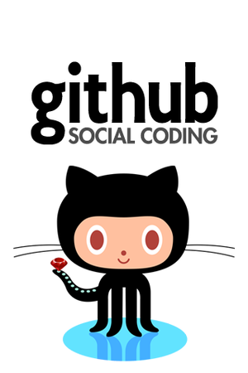
GitHub
Rally’s public portal for both production-grade and community apps
Access Rally Apps and source code
Also includes hackathon (“experiment”) entrants
You have the ability fork, extend, merge
Organizations @ GitHub
RallyApps # production apps
RallyCommunity # quality entries from the public
RallyHackathon # experiments
RallyTools # from rally support engineers
Get started github (https://github.com/RallyApps)

Slide 15
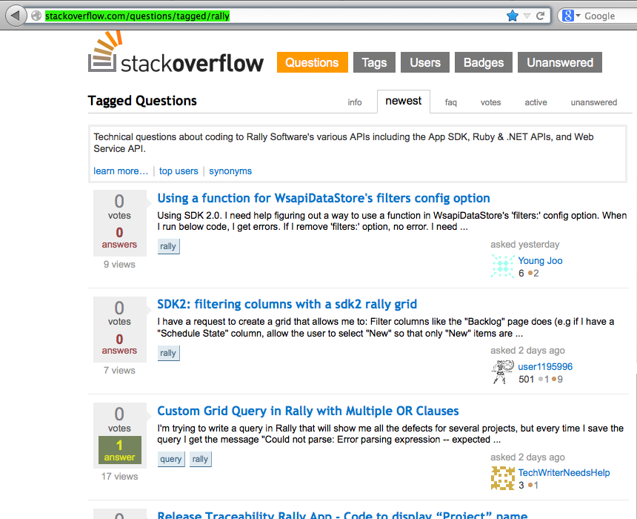
Stackoverflow
When in doubt, phone a friend. Or a few thousand of them on stackoverflow.
http://stackoverflow.com/questions/tagged/rally

Slide 16
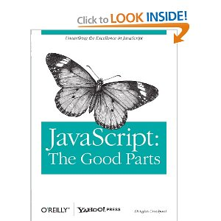
Resources
http://developer.rallydev.com
Rally & Ext APIs in one place (Rally only guides though)
http://docs.sencha.com
KILLER examples and guides!
Book: Javascript the Good Parts, Douglas Crockford
(http://www.amazon.com/JavaScript-Good-Parts-Douglas-Crockford/dp/0596517742)

Slide 17
This slide intentionally left blank
(except for this text)

